Slide 1
Storytelling with R
OR: How to turn a finding into a story

Slide 2
Newton’s (inferred) law of people reading stuff:
Most people don’t want to read/consume things that feel like work. But you can make decisions that make even complex topics and findings less work.

Slide 3
So what makes a good story?
Here are some things journalists think about when they are working on a narrative:
A story has characters - people seem to sympathize most with people as characters, but they can also be an entity like a corporation, or a system like a school district.
Protagonists and antagonists - sometimes this means good guys and bad guys, but obviously sometimes that is a ridiculous oversimplification. More generally, this is the entities whose experiences will serve to advance the story.
A story has a setting, making it richer by grounding it in a place.
Beginning, middle, end - Here’s the setup. But wait! It is more complicated than that. But then the story is resolved in some way. The same information, structured differently, can tell a much more interesting story.

Slide 4
How does data fit in?
Some common ways:
Using data, we have established a pattern, and it is telling us which way the story should go. We want characters who illustrate this pattern.
Using data, we have identified outliers, and we want to give them the attention they deserve. In the investigative journalism world, we usually don’t mean attention in a good way. In investigative journalism this is often more specifically bad actors. #FFS
Data contributes insights into the mechanisms by which something happens. We’ve learned something new about how something works. Caution: specifics will nearly always be more readable than generalizations.
On extremely rare occasions the process (data acquisition, methods) is interesting

Slide 5
Is your work relevant?
Our society is a cesspool (s***hole?) of inequality, corruption and dysfunction.
Does your work highlight someone or something that needs to change? Is someone or something to blame? Who has the power to change the situation?
How does your work intersect with this?

Slide 6
Give some thought to units
Can you base your inputs and outputs in tangible things?
number of people vs. infections per respirator hour
Jobs vs. FTEs
Dollar$ vs. percent change

Slide 7
Methods
Data analysts often don’t realize how much the design of an analysis determines what they will be able to say later.
One example: Odds v. Risk
Can you run it both ways?
Sometimes it is a successful strategy to analyze the most robust way, and also a simpler more-explainable way. This way you can be more accessible without sacrificing rigor.

Slide 8
Help people make sense of it
Give people a framework and context to make sense of it all.
Often people don’t want dashboard-type data without a framework for understanding. That doesn’t mean being overbearing or non-transparent.

Slide 9
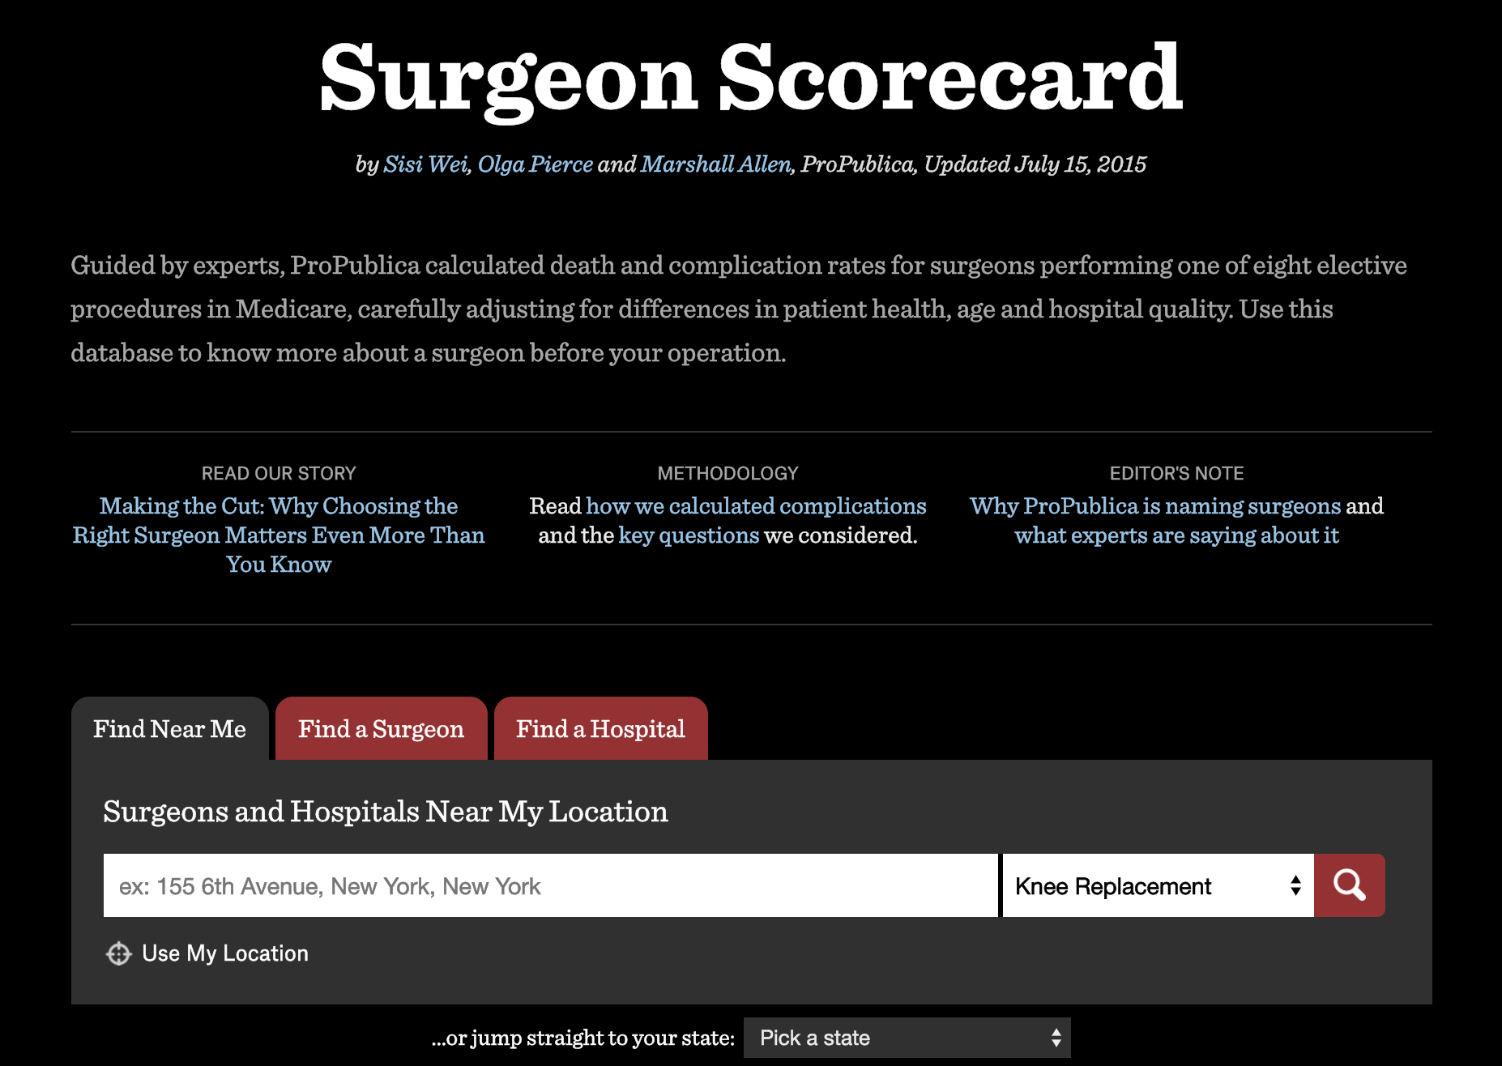
Case study #1: Surgeon Scorecard

Slide 10
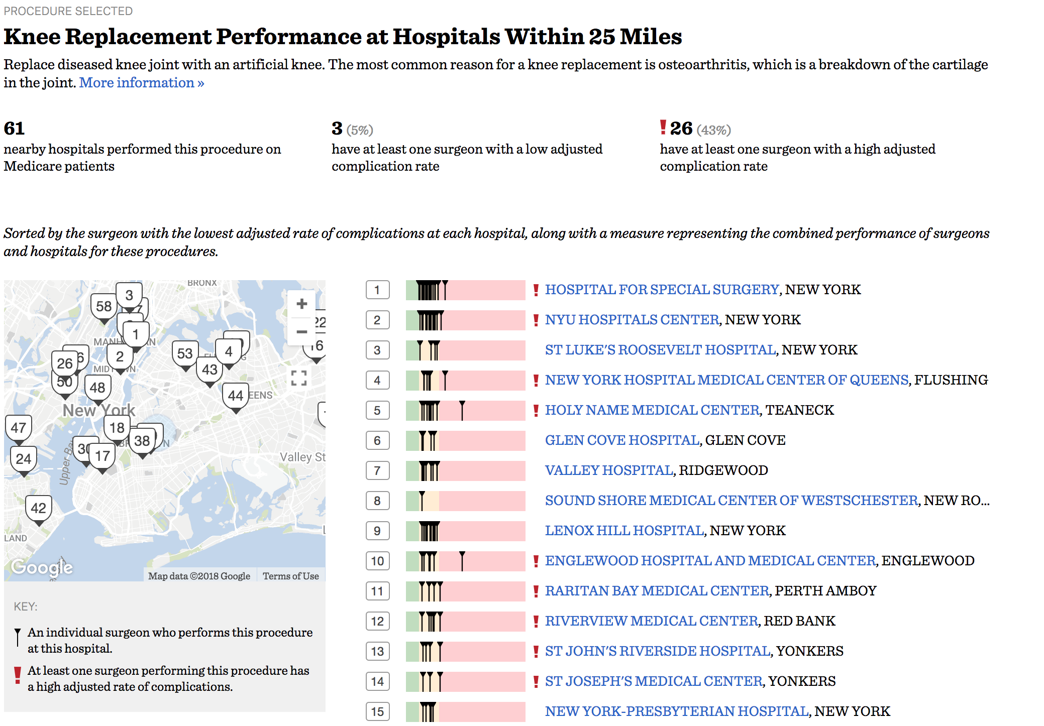
Case study #1: Surgeon Scorecard

Slide 11
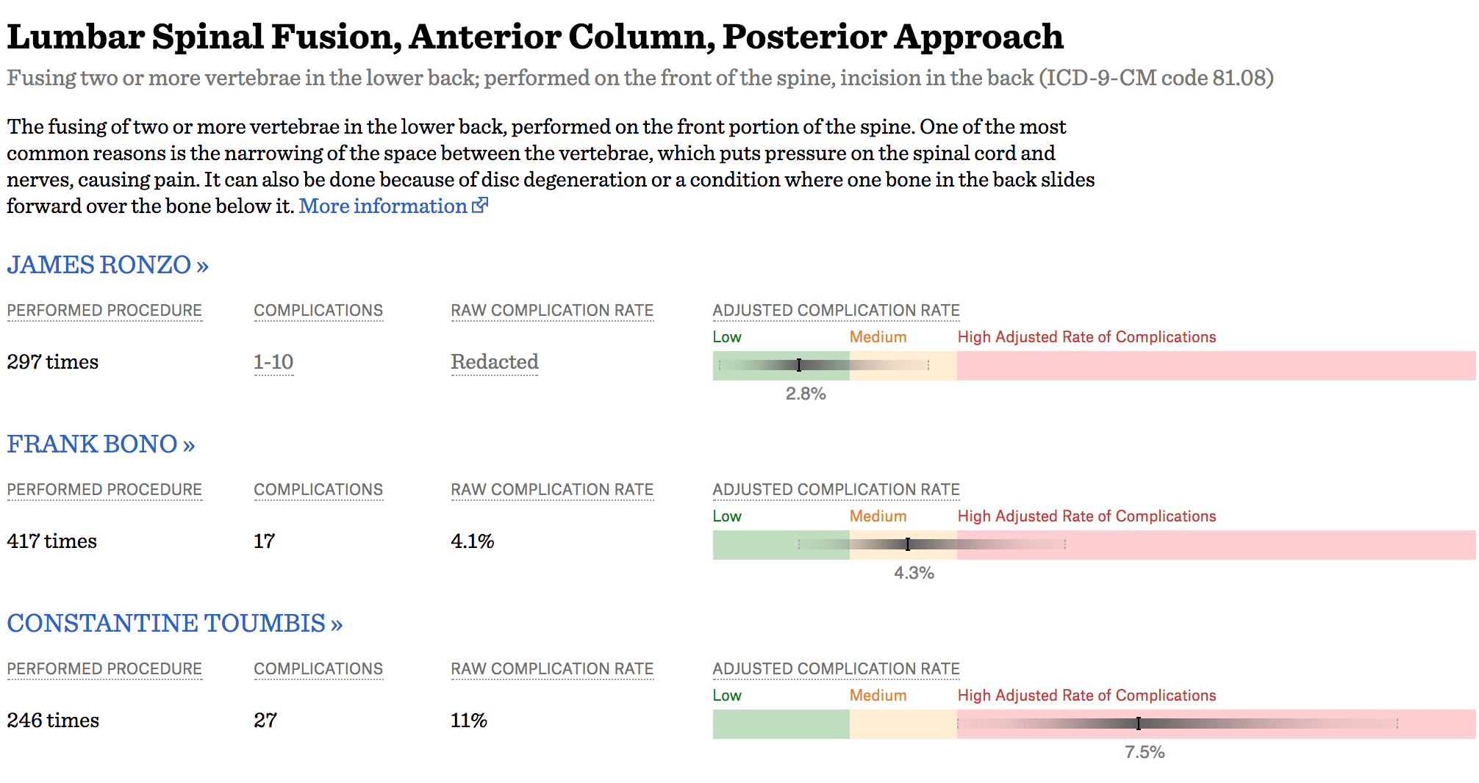
Case study #1: Surgeon Scorecard

Slide 12
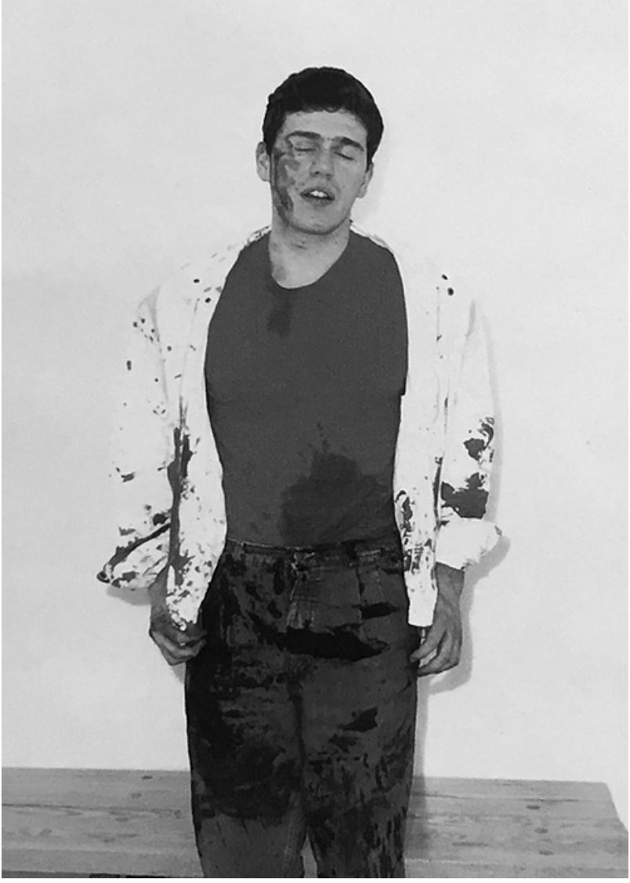
Case study #1: Surgeon Scorecard
While in medical school, Toumbis slashed a friend’s throat with a large knife.
Though he was required to disclose this in the Florida licensure process, he failed to do so. In some cases, he omitted it altogether. In another, changed the story, saying he was the victim of the attack.
Photo color altered to be less visceral.

Slide 13
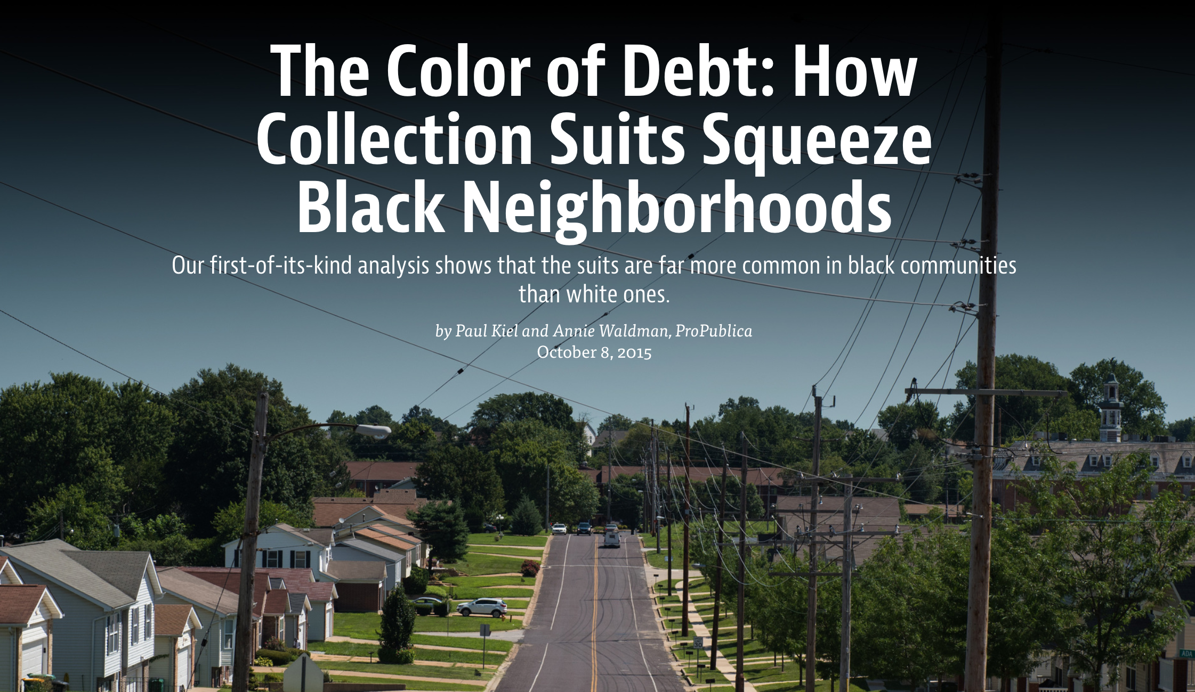
Case study #2: Color of Debt

Slide 14
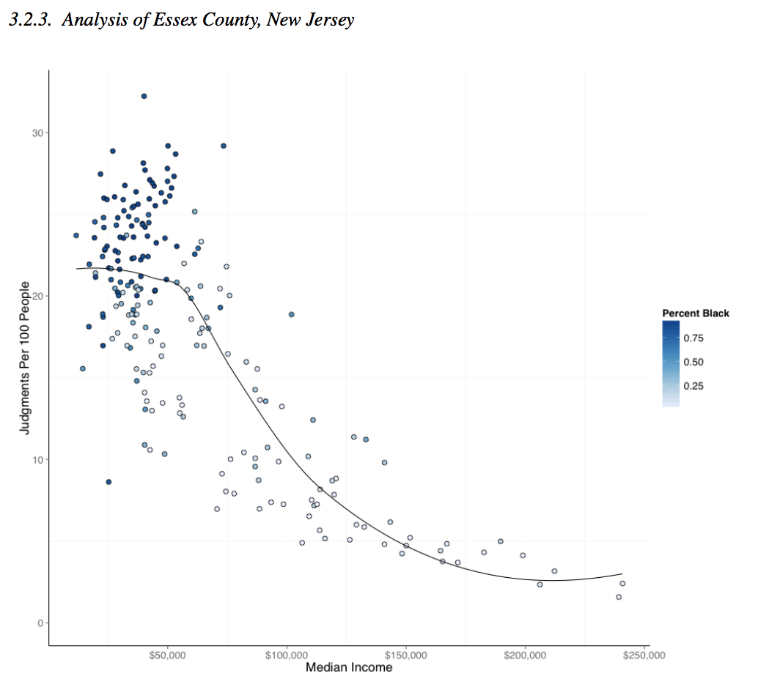
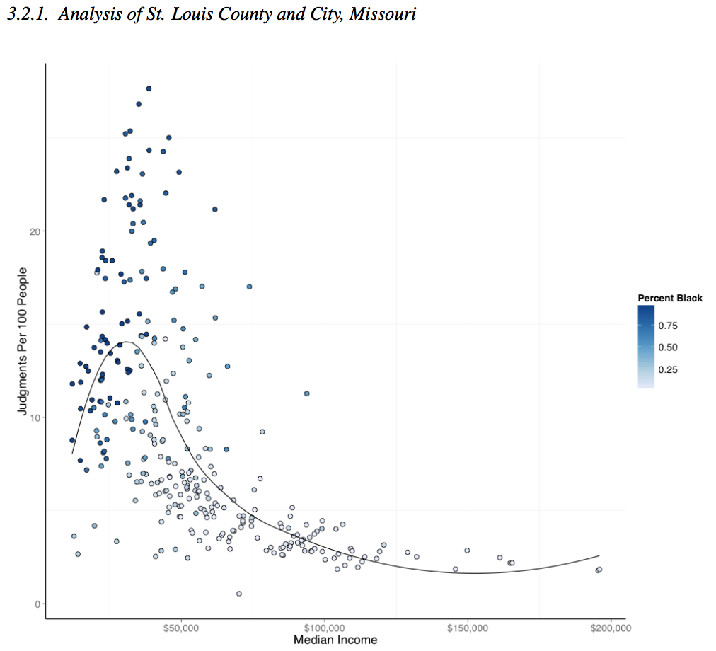
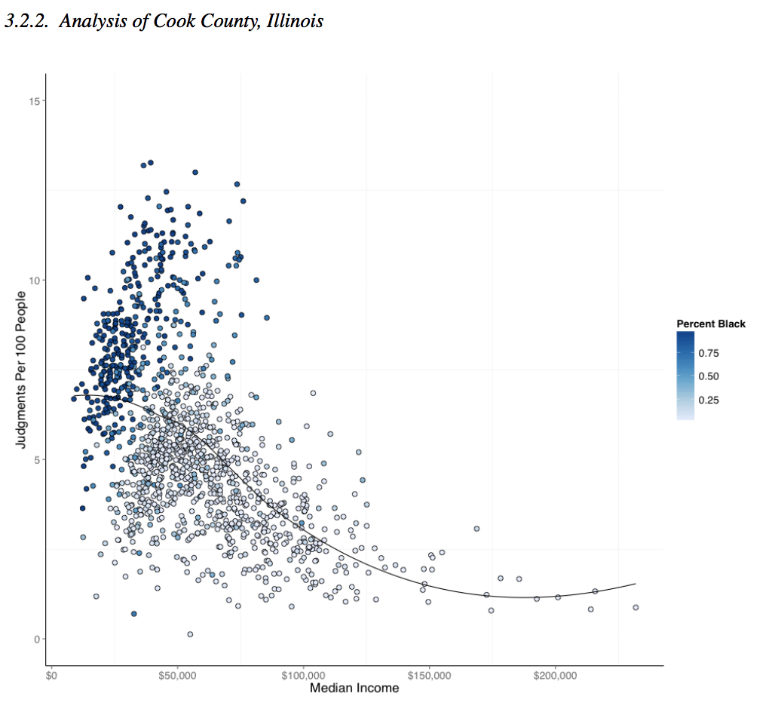
Case study #2: Color of Debt

Slide 15
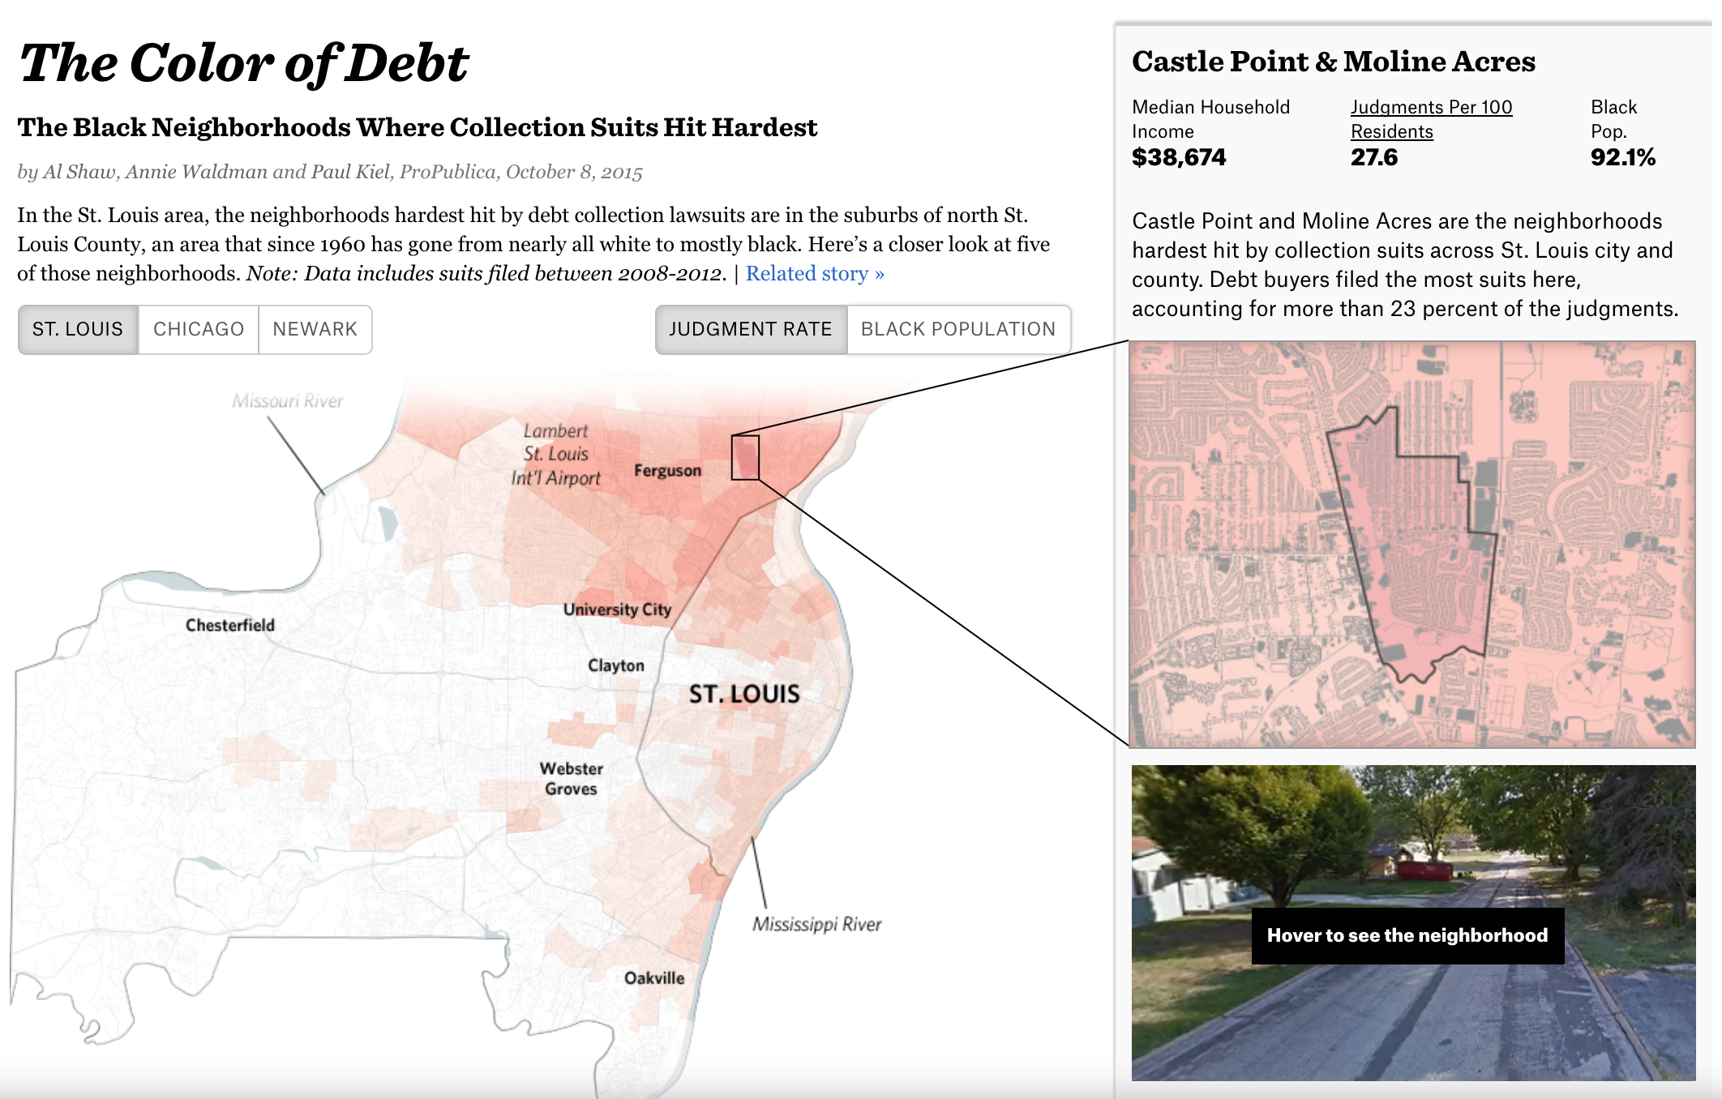
Case study #2: Color of Debt
Notes:
So here’s what we came up with ...

Slide 16
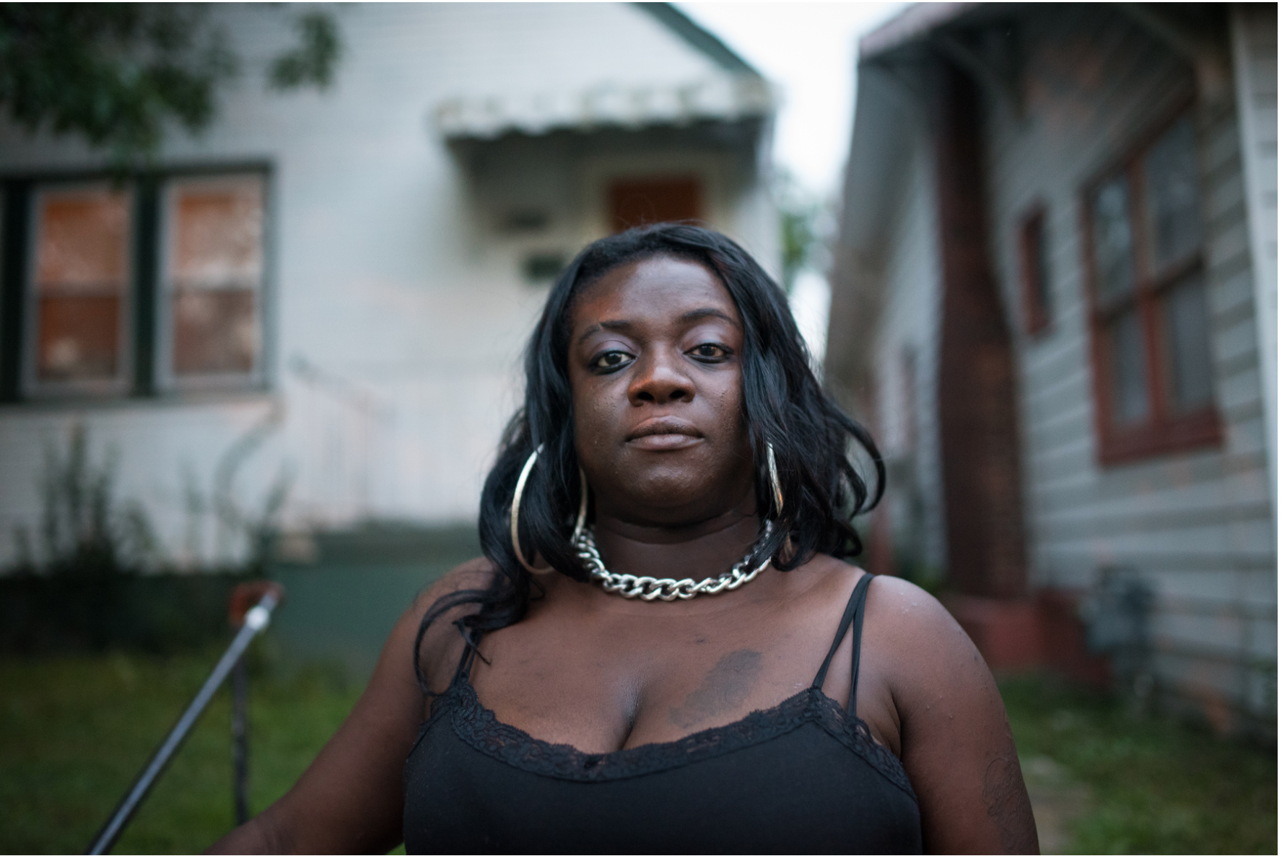
Case study #2: Color of Debt

Slide 17

Case study #3: Machine Bias

Slide 18
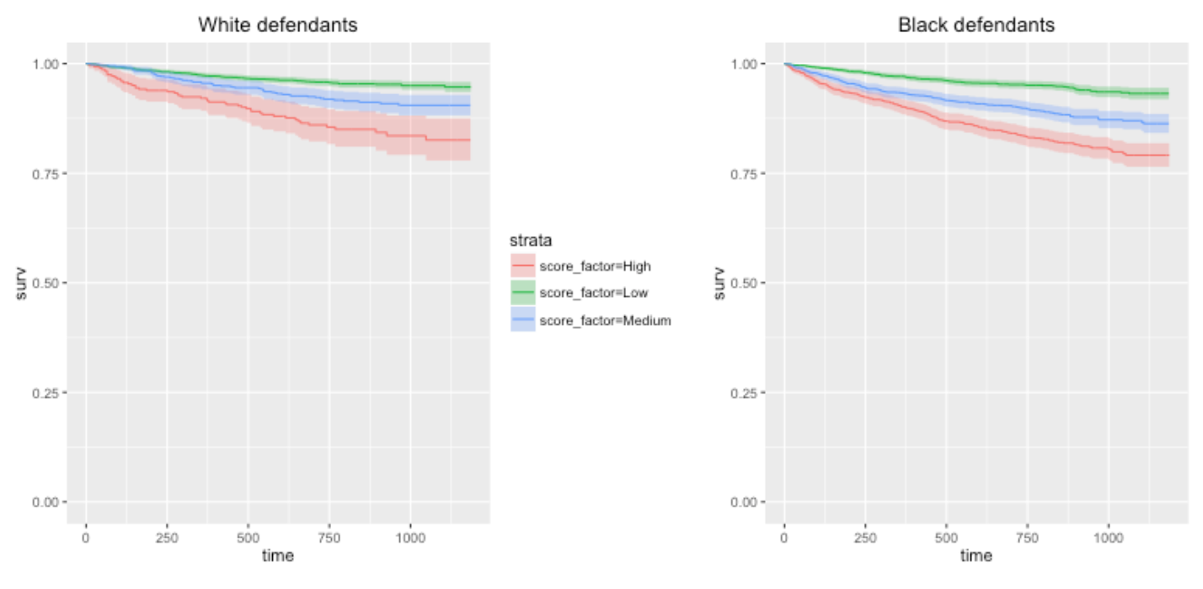
Case study #3: Machine Bias

Slide 19
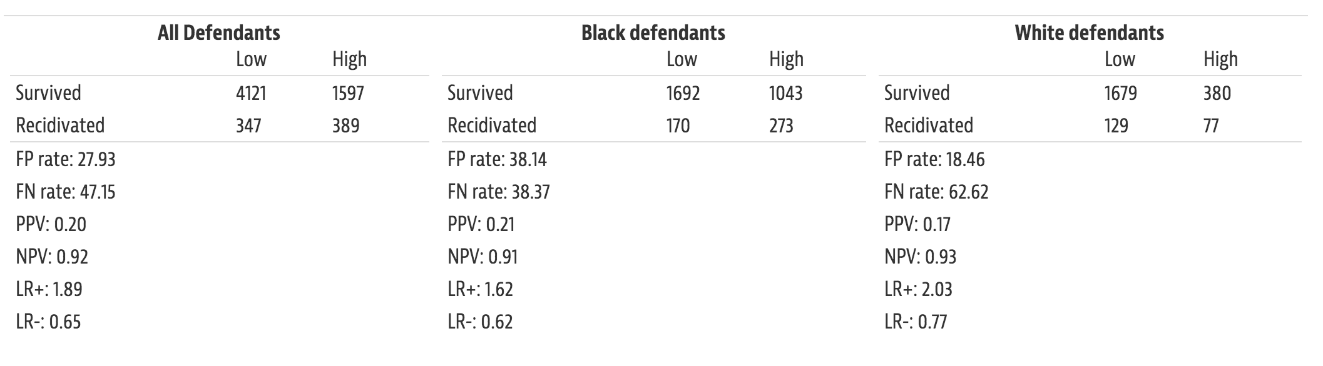
Case study #3: Machine Bias

Slide 20
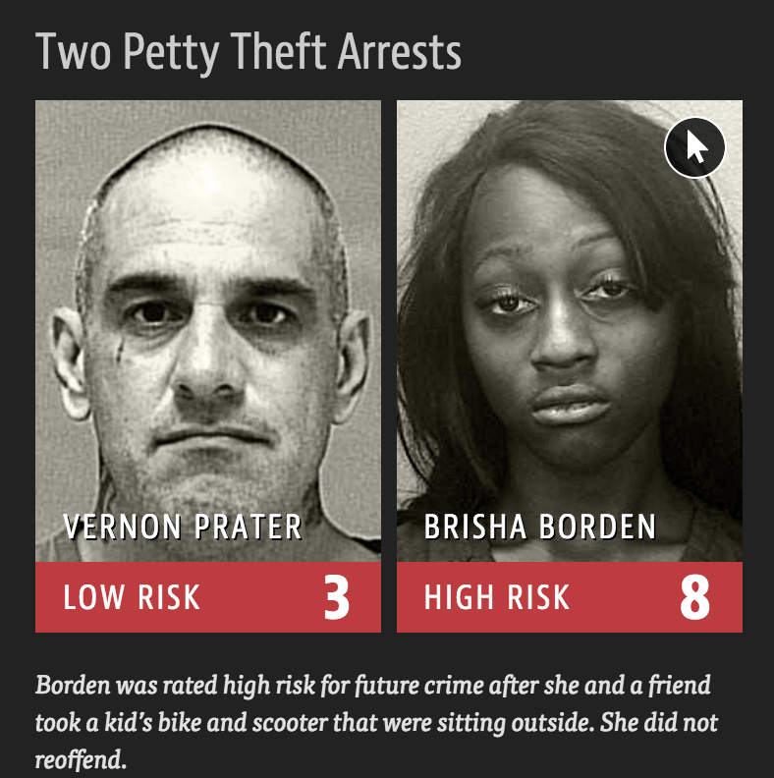
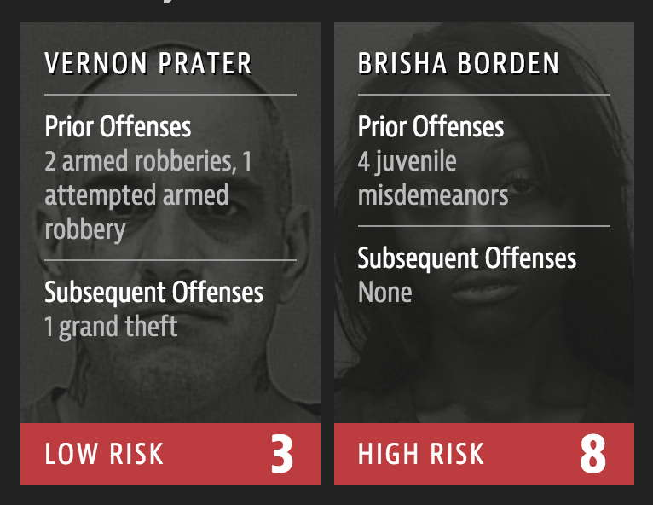
Case study #3: Machine Bias

